Slide 1

AGENDA Problem Target Customer Solution Use Case/Prototype Business Model
Group 6: Reka

Slide 2

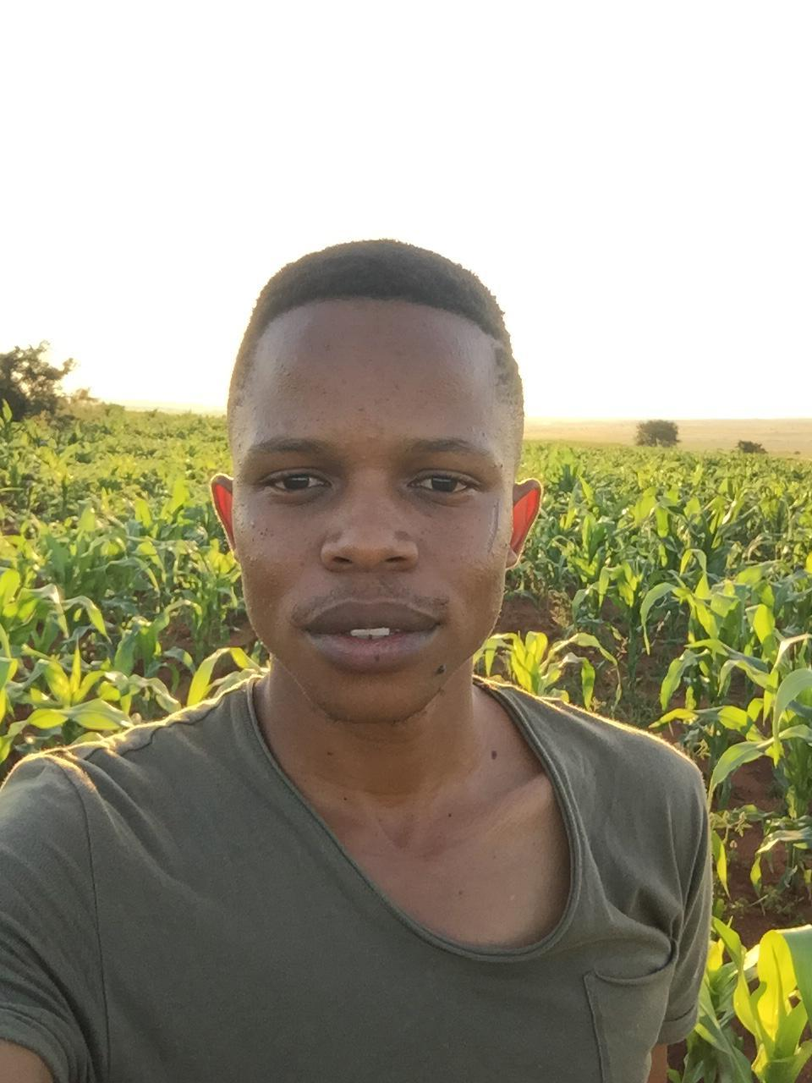

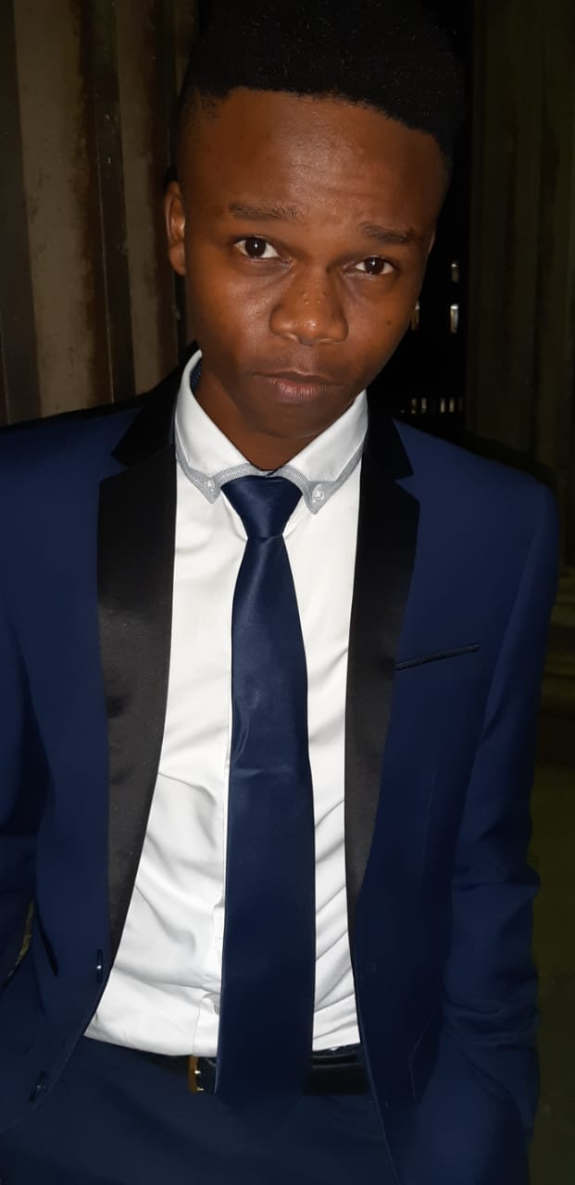
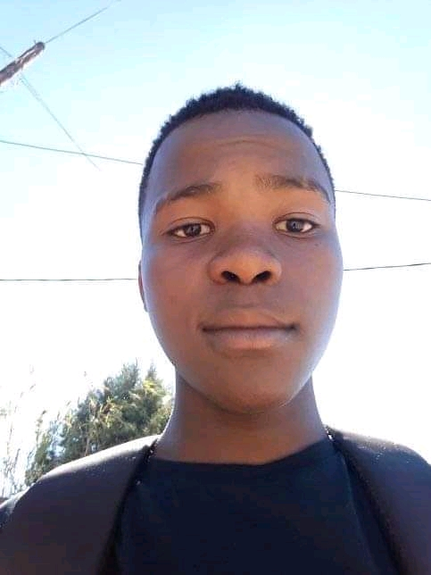
MPHO
KHUTSO
NTHABISENG
MEET REKA
LESEDI
MONT’SO

Slide 3

TARGET CUSTOMER
The De Beers Family
Upper-middle class + high-income households
Ideally a homeowner
Aware about their energy consumption
Monthly bill: R1250 to R5000
Income: R300K to R1.2M
market size
Approx. 1 323 000

Slide 4
PROBLEM
TRACK energy usage before the bill comes
CUT DOWN on electricity consumption
OPTIMIZE power at desired level of price
Majority of South Africans are “energy poor”
At least 10% of their income is spent on electricity
Eskom’s tariffs are higher than before
WHY NOW?

Slide 5
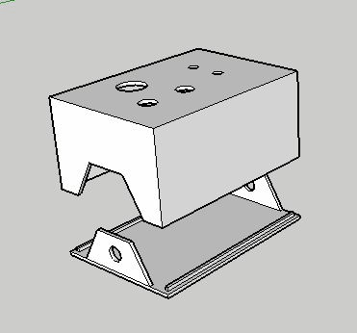
SOLUTION
A physical device to track and give:
Precise real-time measurements
Comprehensive
readings
Different ways to optimize energy
Plus a mobile application to display any electrical activity with an intuitive interface
WHY US?
REKA Tracker
Adaptive device
Incentive for “good” behaviour
Peer-to-peer suggestions

Slide 6



VALUE PROPOSITION
An annual bill of R15 000 on average
3 x tracker devices for main appliances
+
Central
unit
+
(For geysers and pool pumps) Installation
= R1882
AND
Price of REKA
Break-even point
Period (in months)
EQUIVALENTLY
CUT 4MIN/PA
OR
CUT 30MIN/WEEK

Slide 7
When? What? Why?
Use Case/ Prototype Demo
FIRST TIME USER
REGULAR USER
Users want consumption reading and saving tips from community
Logs into the app
Access account & usage details. Store information on the cloud
Consumer needs to manage their energy & budget.
A tracker w/ sensor + central unit and a free app
Above three are needed for full use of the product.

Slide 8
BUSINESS MODEL
____________________________________________________________________________________________________
Acquisition of customers through:
Word of mouth
Flyers
Gym classes
First set of customers will be from the northern suburbs of Johannesburg
Orders are taken before producing the devices
Milestone: creating programs to facilitate more R&D on perfecting our technology
Growth: expanding to Pretoria and the whole of Gauteng

Slide 9
FINANCIALS

Slide 10
KEY TAKEAWAY
Optimize to use energy wisely and reduce budget
Adaptable REKA tracker
Selling you and opportunity to choose your lifestyle

Slide 11

SPECIAL THANKS TO THUNZI AT THE MAKER’S SPACE

